Slide 1


Slide 2


Slide 3

Ancrage
Voice-first home companion for people
with light-to-moderate loss of autonomy
HackEurope - 2026

Slide 4



THE PROBLEM
Aging alone is a silent crisis
2.5M
11M
€43B+/year
people with loss of
autonomy in France
informal caregivers,
often overwhelmed
on autonomy support
For eldery people

Slide 5





THE SOLUTION
One device. Zero friction.
For the person at home
For caregivers
Smart medication reminders
Real-time health dashboard
On-demand help & conversation
Behavioral trend reports
Contact family by voice
WhatsApp alerts
Cognitive stimulation exercises
Schedule reminders remotely
Scam protection layer
Peace of mind, at a distance

Slide 6
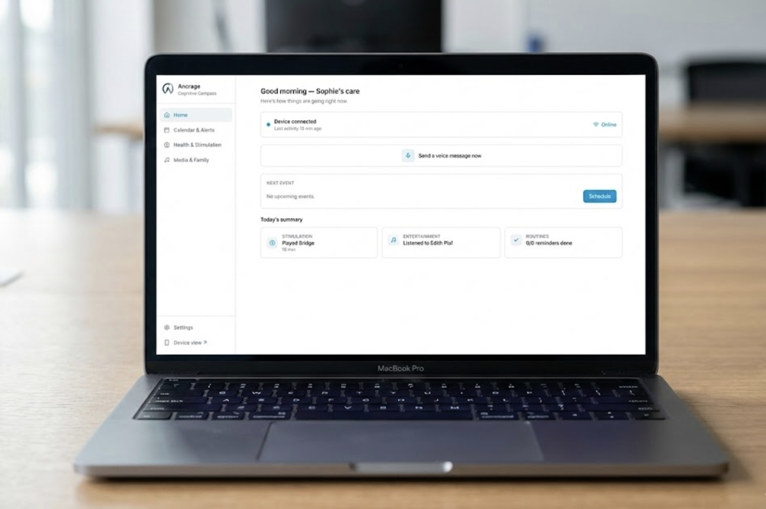
THE SOLUTION
One device. Zero friction.
For caregivers
Real-time health dashboard
Behavioral trend reports
WhatsApp alerts
Schedule reminders remotely
Peace of mind, at a distance

Slide 7


WHY CARELOOP
What sets us apart
Zero-friction interface
Persistent personal context
Proactive, not reactive

Slide 8
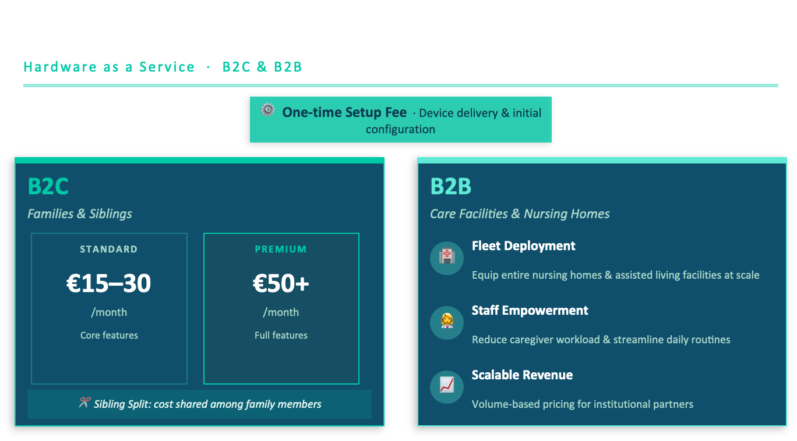

Slide 9

Because caring shouldn't be a burden.

